Slide 1

Msds 670 data visualization final assignment
Paige Keller

Slide 2
Table of contents
Research Question
Methodology
Results
Conclusion

Slide 3
Research question
Does population size effect crime rates?
What impact does population have on crimes?
How does population size effect different variables of crime?

Slide 4
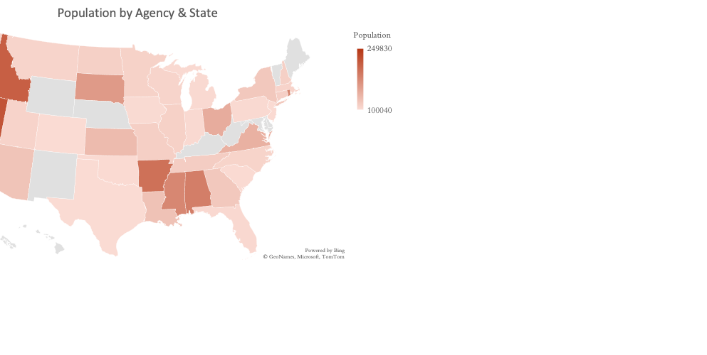
Methodology
The dataset was extracted from the FBI-UCR website for the year of 2012 on populations less than 250,000
The 2012 crime dataset was submitted to UCR by various US County Police Departments
The dataset includes 216 counties with 12 variables: population, violent crime total, murder and manslaughter, forcible rape, robbery, aggravated assault, property crime total, burglary, larceny theft, motor vehicle theft, and latitude and longitude
Dataset from:
https://www.kaggle.com/mascotinme/population-against-crime
Chart shows the city population based on the agency department. Darker red shows areas with closer to 250,000 while the lighter areas are either not included in the dataset or have a lower population count.

Slide 5
Majority of the populations fall within the trend-line but three (shown by red dots) classify as outliers
Counties with populations under 115,000 saw more violent crime totals
As population increases so does the violent crime total

Slide 6
California shows the highest armed robbery total followed by Florida
IL, MN, MT, ND, NH, OK, TN show the lowest armed robbery totals, barely showing above the zero marker
Higher populations showed higher armed robbery totals

Slide 7
It’s a 969.8% change from South Dakota’s forcible rape (139) for the 5th least populous state, compared to California (1,487) the most populous state
Murder and manslaughter sum is significantly smaller than all of the top five most populous states in the left chart
It’s a steady decrease in forcible rape in the five most populous states
As the population increases in the right chart, forcible rape increases

Slide 8
Conclusion
When looking at violent crime total vs population, majority of the populations follow the trend-line but have a few outliers
- Counties with populations under 115,000 saw more violent crime totals than those with larger populations
Armed robbery by state shows that California had the highest total followed by Florida
- Overall, showing that states with higher populations had more armed robbery occur
The murder/manslaughter sum is significantly smaller than all of the top five most populous states although it’s a steady decrease in forcible rape in the same states
- In the five least populous states, as the population increases, forcible rape increases

